Slide 1

CHESS Compact Undulator*
A. Temnykh, T. Kobela, A. Lyndaker, J. Savino, E. Suttner and Yulin Li
CLASSE & CHESS Laboratory, Cornell University, Ithaca, NY, 14853, USA
*This work was supported by NSF awards DMR-0936384 and DMR-0807731

Slide 2
Presentation outline
Undulator concept and general properties
Design and fabrication aspects
Test results
  Mechanical
  Magnetic
  Vacuum
Project status
Conclusion

Slide 3
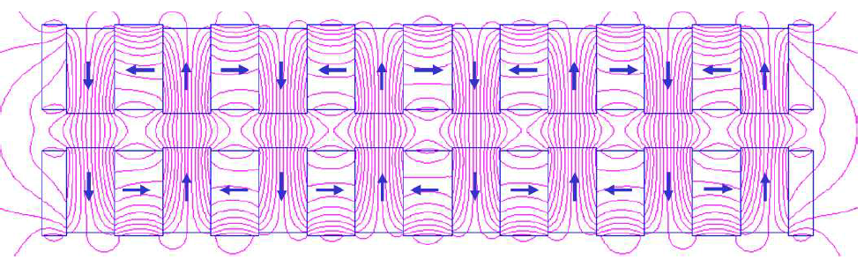
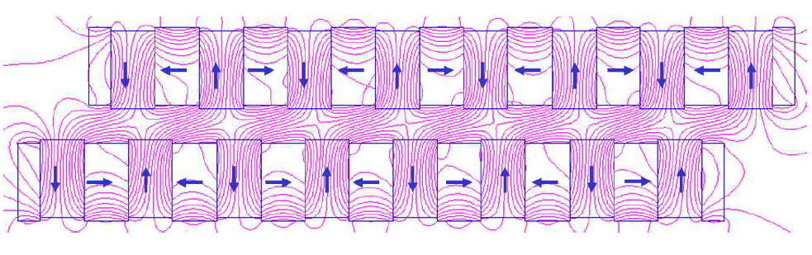
Introduction
AP scheme illustration
Adjustable Phase scheme developed by Roger Carr in ref [1].
Features
Constant gap (no beam impedance variation)
Alternating longitudinal magnetic field on beam axis for “non zero” phase
Constant vertical beam focusing
y
z
0⁰ phase, By = Bmax
[1] R. Carr, Nucl. Instrum. Methods Phys. Res., Sect. A 306, 391 (1991).
114⁰ phase, By = 0.54 * Bmax

Slide 4
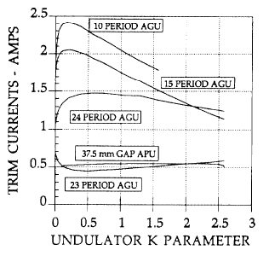
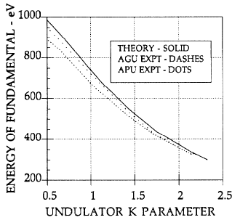
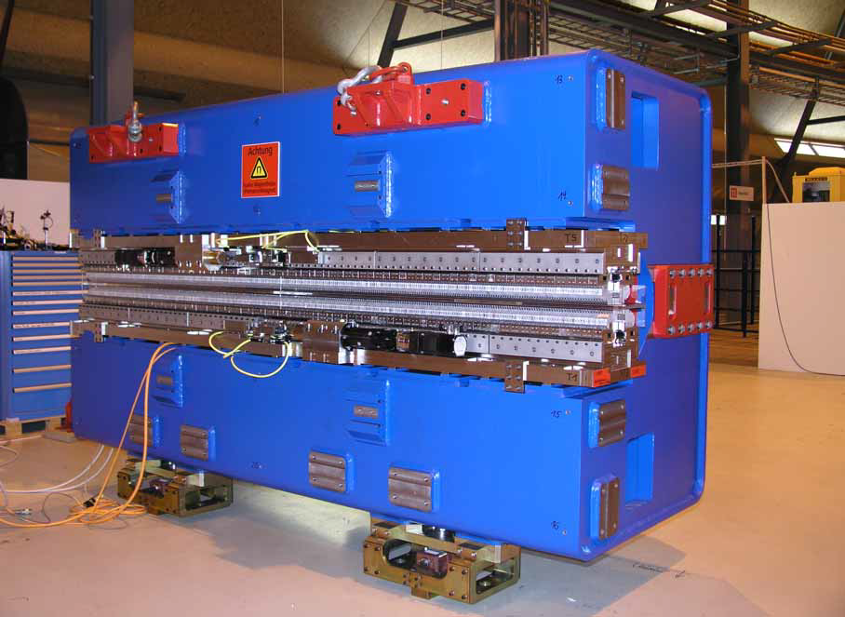
Introduction
Two APU (fixed gap) undulators have been built so far
SPEAR
1992 SPEAR , 38mm gap, 77mm period, ~1.8m long, “First Test Results for an Adjustable Phase Undulator” R. Carr, H.-D. Nuhn, J. Corbett, SSRL, In Proc. EPAC 92
2006, Swiss Light Source (PSI),
11.6mm gap, 44mm period, 3.2 m long
APPLE II fixed gap undulator at ADRESS beam line.
Picture copied from “A Fixed Gap APPLE II Undulator for SLS” by T. Schmidt, A. Ingold, B. Jakob and C. Vollenweider, In proceedings SRI 2006
SPEAR
SLS UE44 fixed gap APPLE II undulator

Slide 5
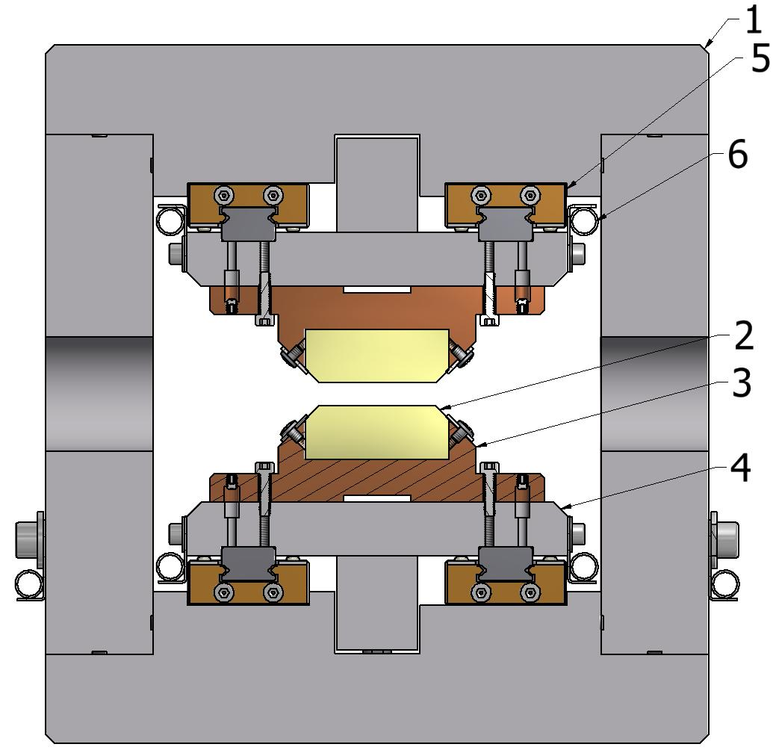
CHESS Compact Undulator concept
Project motivation:
Needs for CHESS Upgrade, presently we use radiation from bend magnets radiation & two PM wigglers.
Verify engineering solution used in DELTA design at high beam current operation.
(1) – thick aluminum plates comprising the undulator frame;
(2) – permanent magnet blocks soldered to copper holders (3);
(4) – base plates holding PM block/holder assemblies;
(5) – miniature rails; (6) – cooling lines.
152 mm
PPM Halbuch structure
5 mm gap, 24.4mm period, Bmax ~1.1T
NdFeBr (40UH grade) with Br ~1.26T
In-Vacuum operation
148 mm

Slide 6
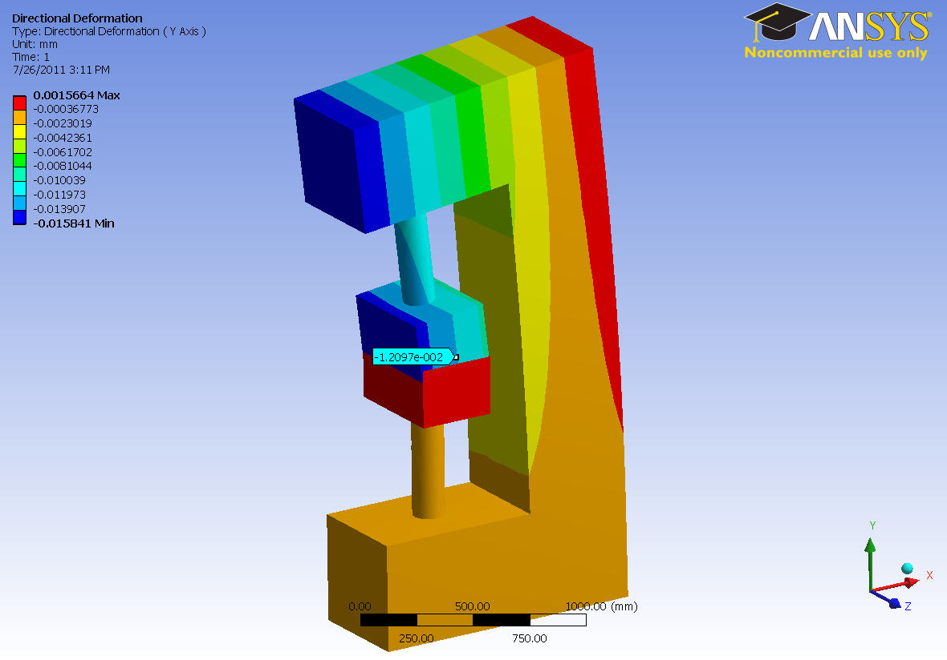
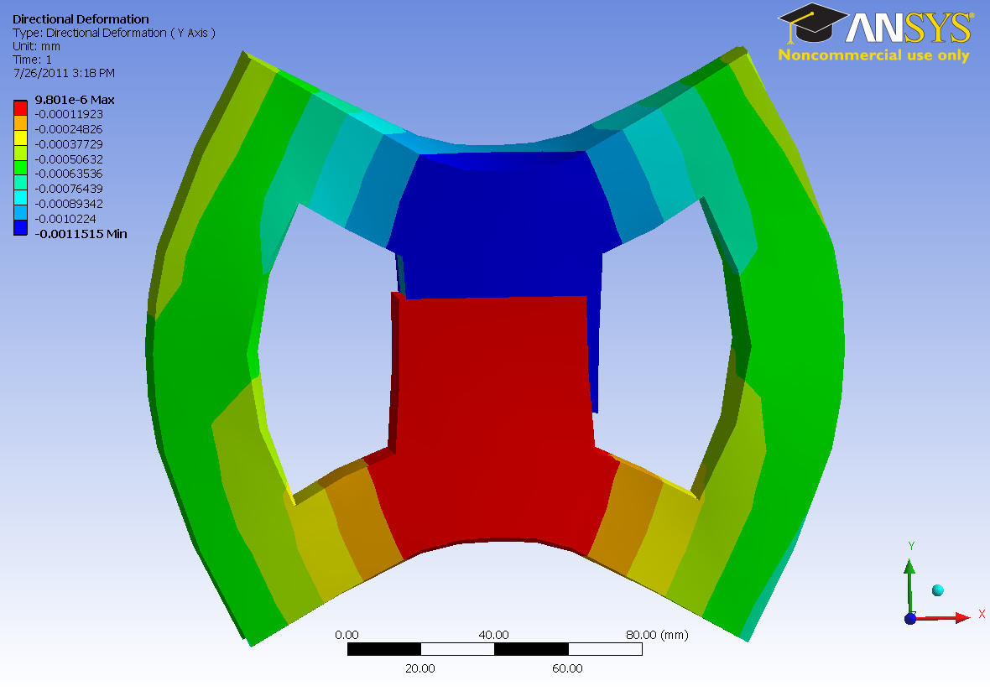
Conventional and box –like frame stiffness comparison
Conventional “C-shape” steel frame
2.3 m x 1.5 m, ~ 9,000 kg weight
10000 N load results in 16 micron deformation
Box-like aluminum frame
150 mm x 150 mm, ~ 83 kg weight
10000 N load results in 1 (!) micron deformation

Slide 7
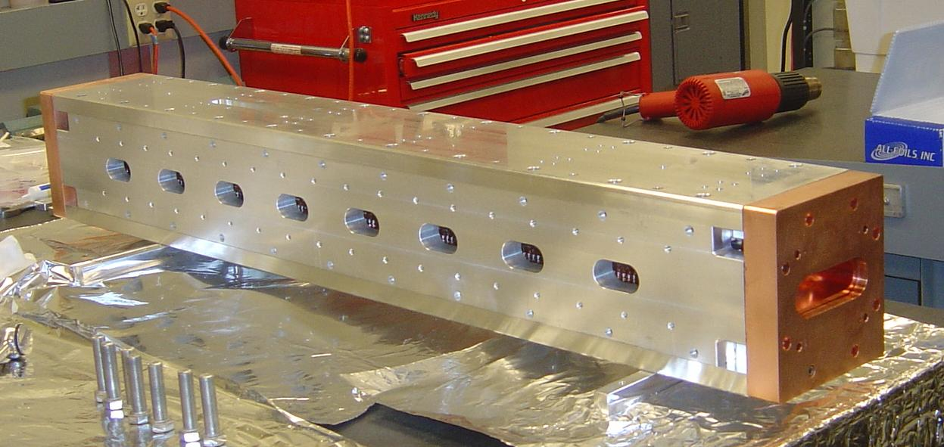
CHESS Compact Undulator concept
Undulator body ~1m long on assembly bench. Weight - 83kg (182 lb)

Slide 8
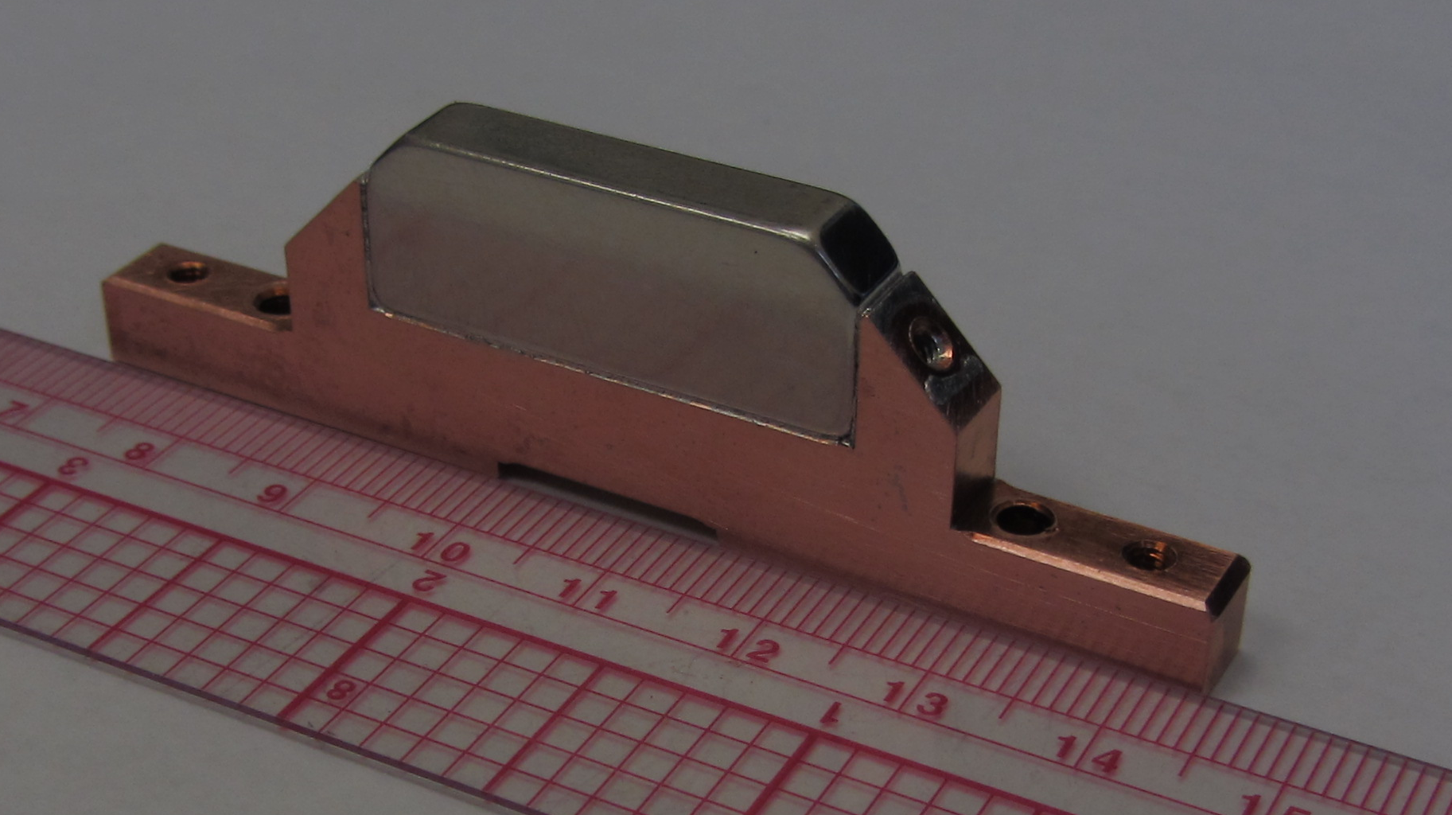
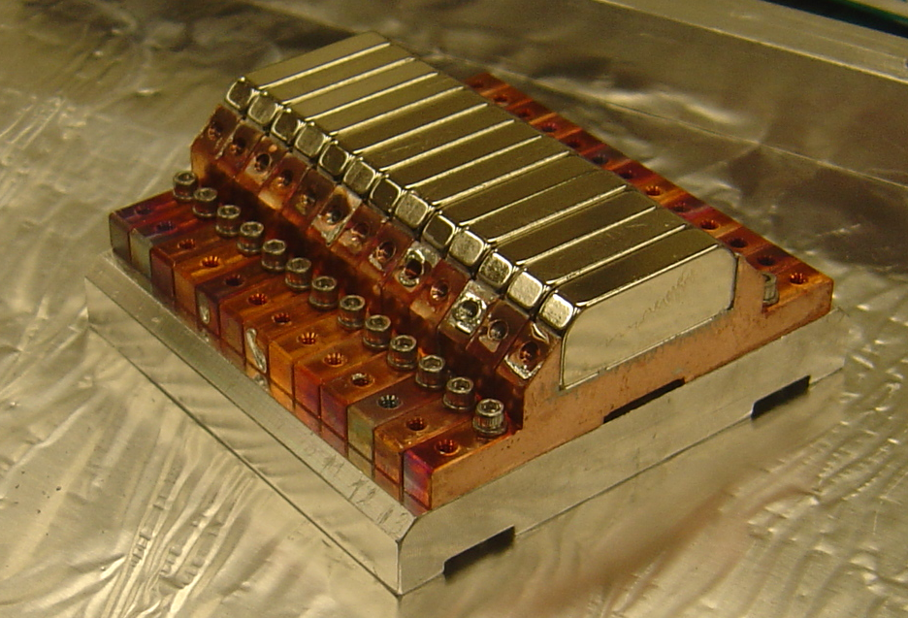
Design and fabrication aspects – PM block soldering to holders
PM blocks are Ni plated
We used Sn63/Pb37 solder with 183degC melting point,
Steel plates
Single PM block soldered to holder
PM block in steel jacked, T_demag ~ 228⁰C !
(US Patent 7,896,224)
Single NdFeB (40SH) PM block, T_demag ~ 132⁰C
Production rate ~ 6 magnet / hr / student
13 blocks test assembly

Slide 9
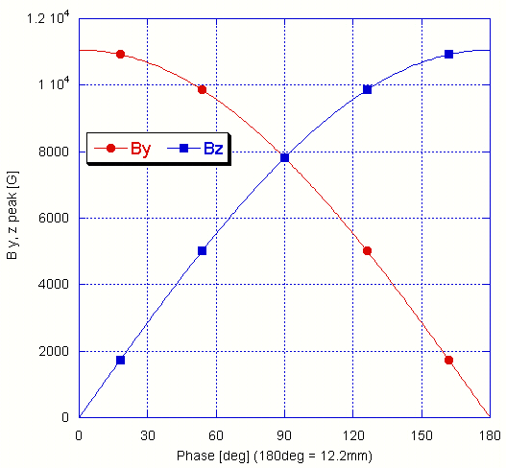
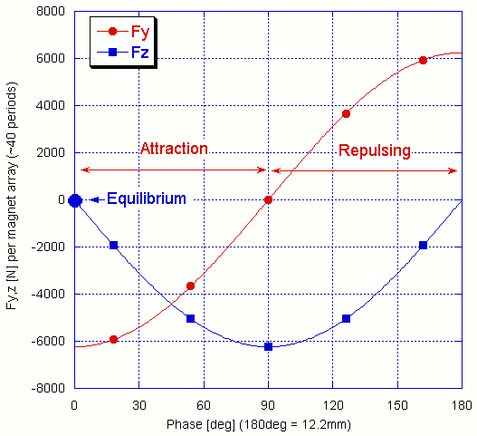
Design and fabrication aspects - Magnet array driver
Peak field as function of phase between magnet arrays
Magnetic forces between magnet arrays
6240 N (1370 lb)

Slide 10
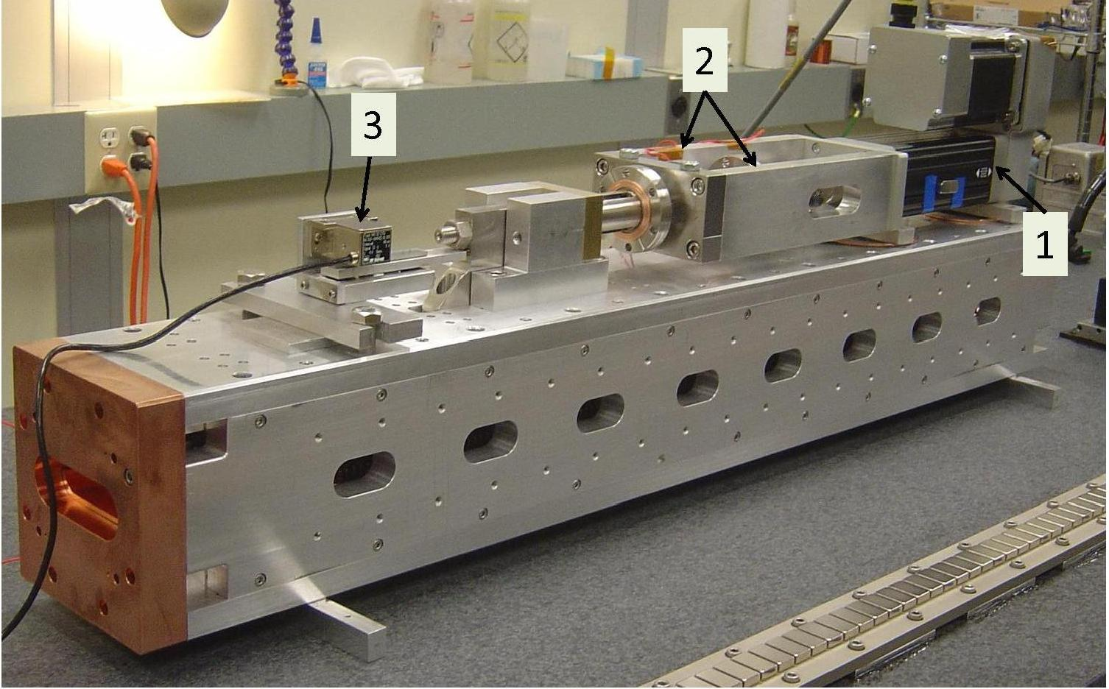
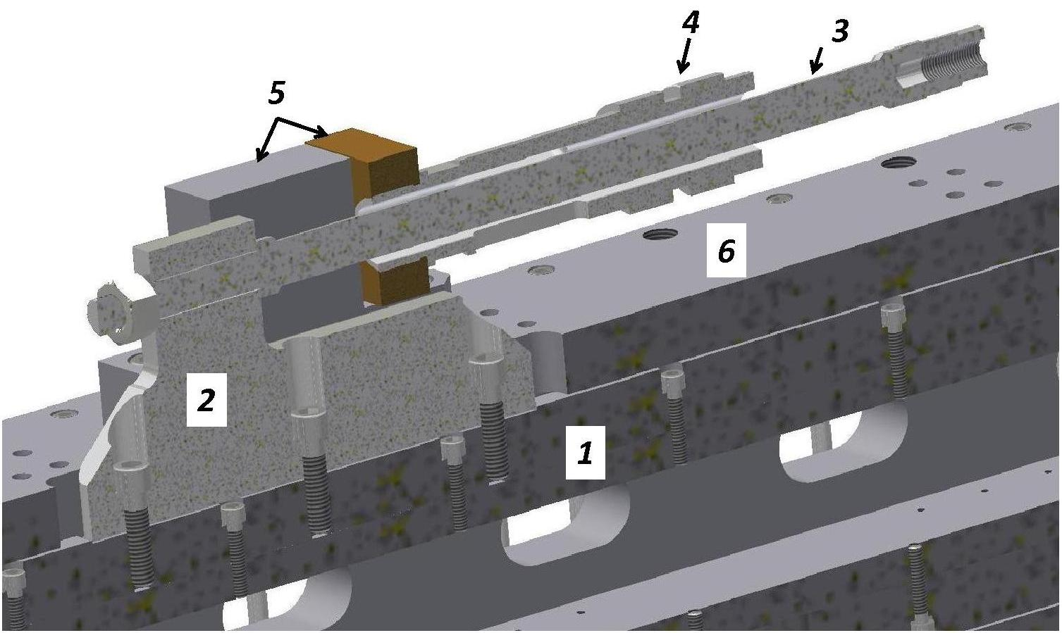
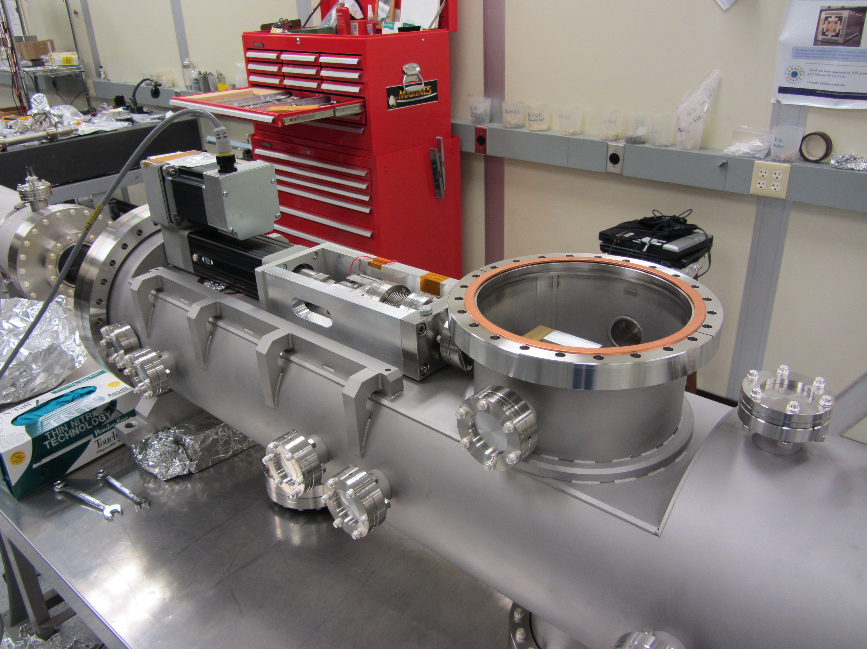
Design and fabrication aspects – Magnet array driver
The magnet array (1) is moved by pulling a stainless steel (SS) rod (3) connected to the magnet array via a SS plate (2). The SS tube (4) attached to undulator frame (6) by the blocks (5) provides the path for the reaction forces.
Linear actuator (EC3 from Kollmorgen, 7200 N spec) outside vacuum vessel

Slide 11
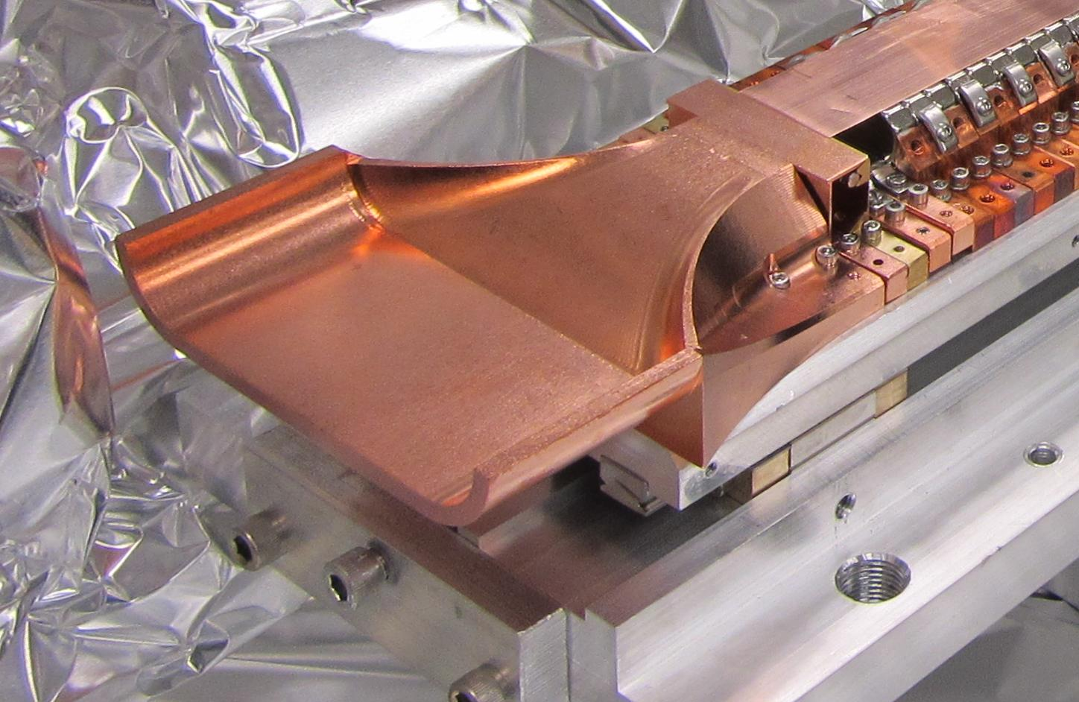
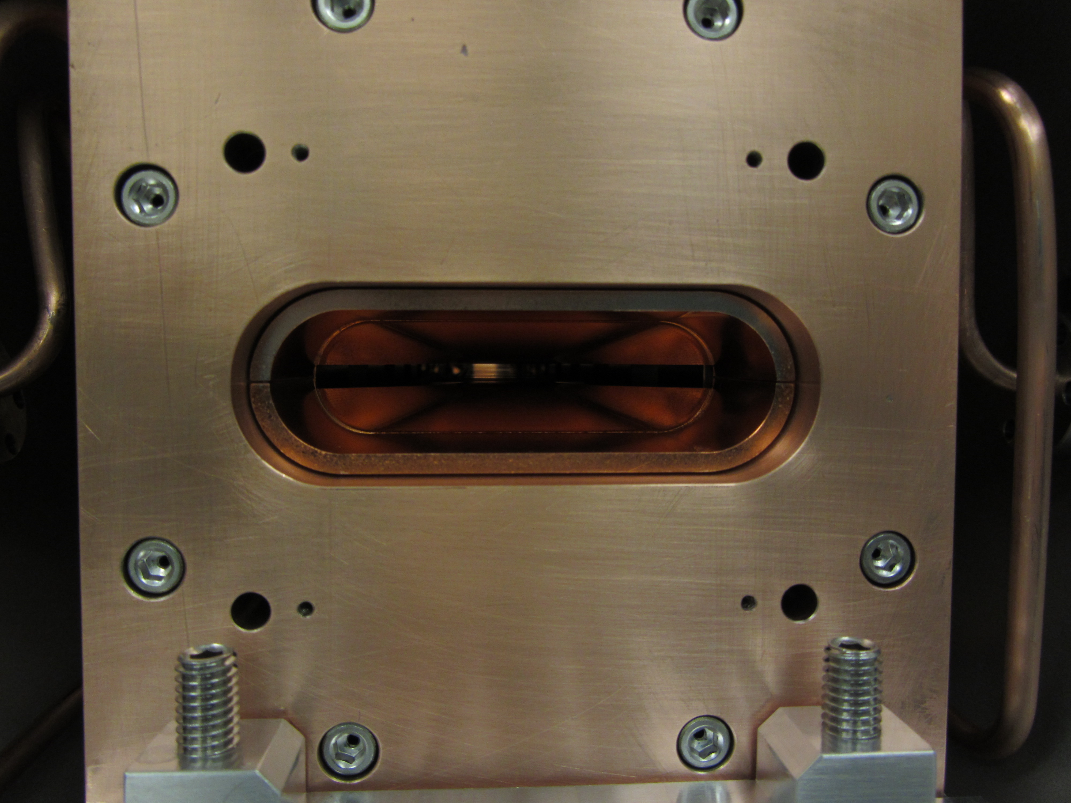
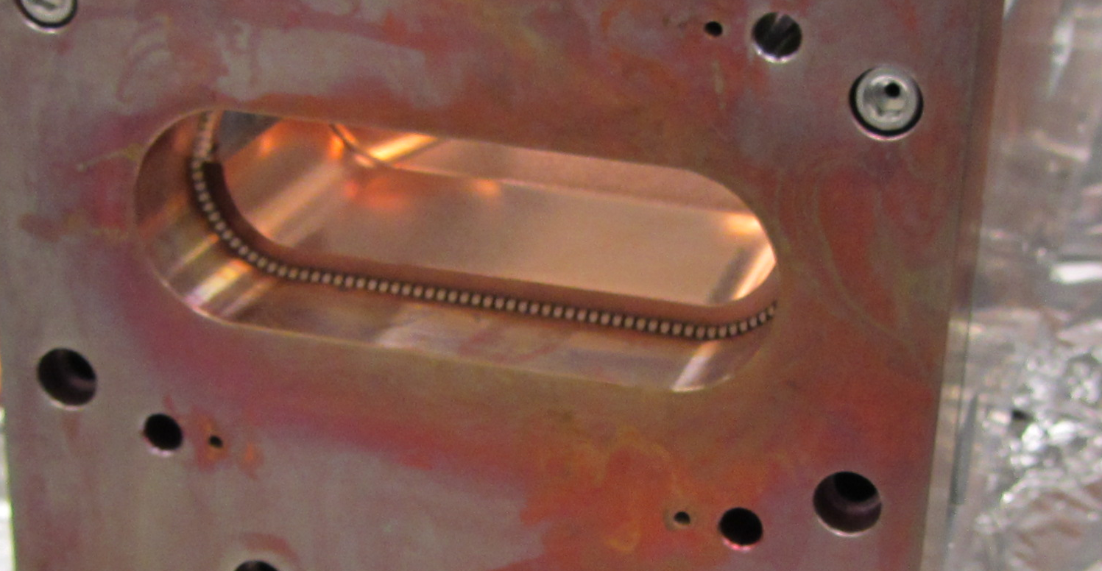
Design and fabrication aspects – Image current path design
(2)
(4)
(1)
1) Solid copper peace providing smooth transition from 25mm to 5mm vertical gap
2) Ni plated (one side) copper foil coating PM blocks
3) RF fingers providing contact between moving array and frame end plate(4).
(3)

Slide 12
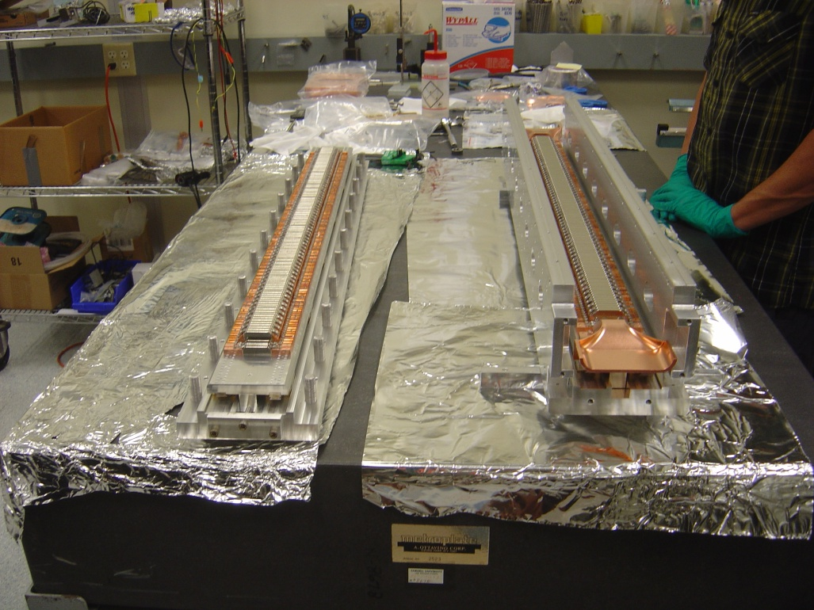
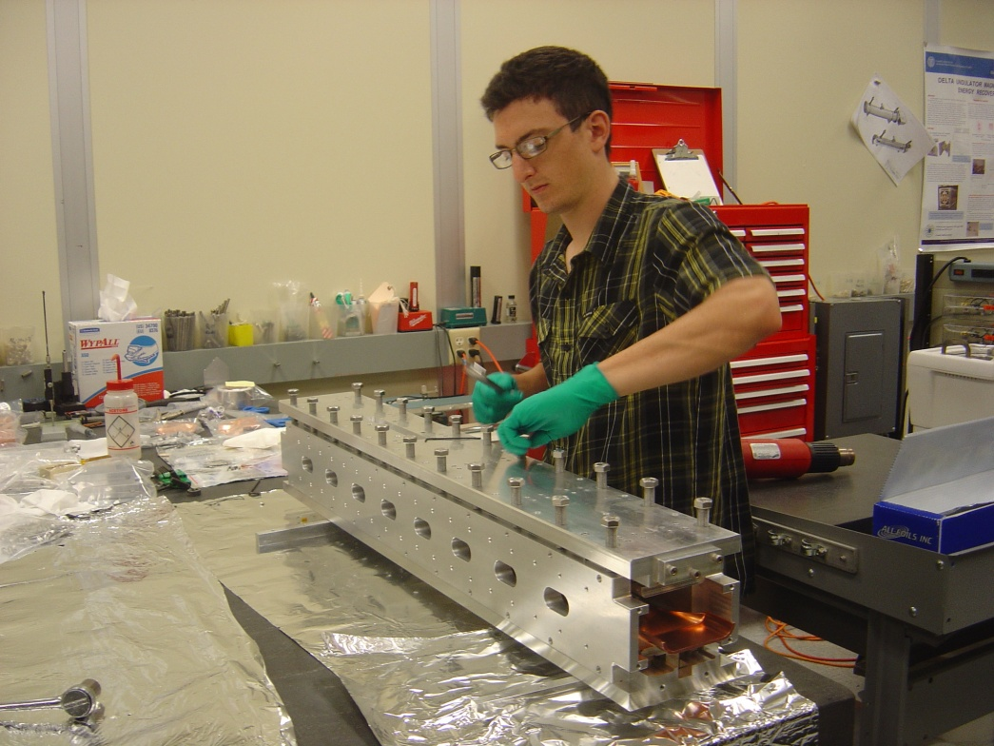
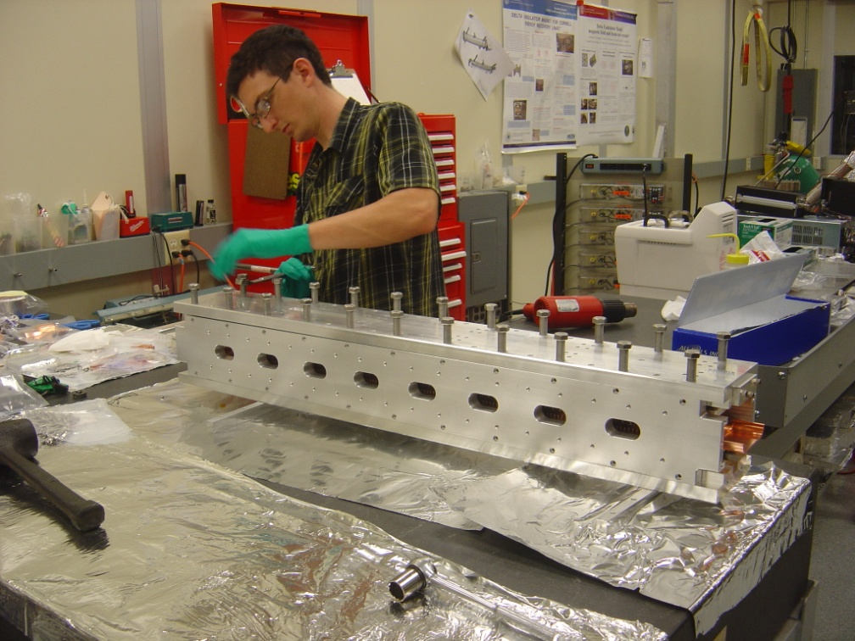
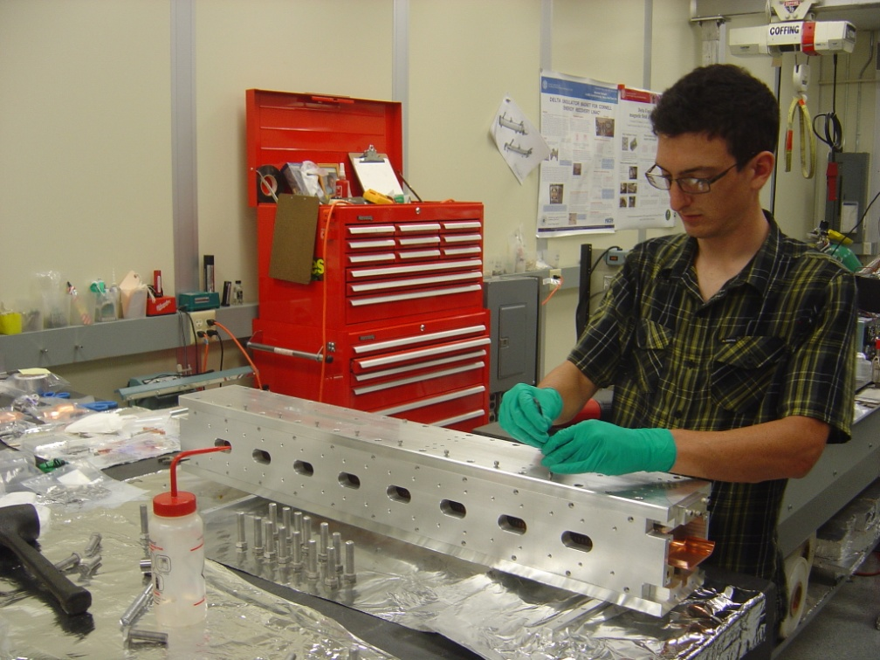
Design and fabrication aspects – Assembly sequence
1
2
3
4

Slide 13
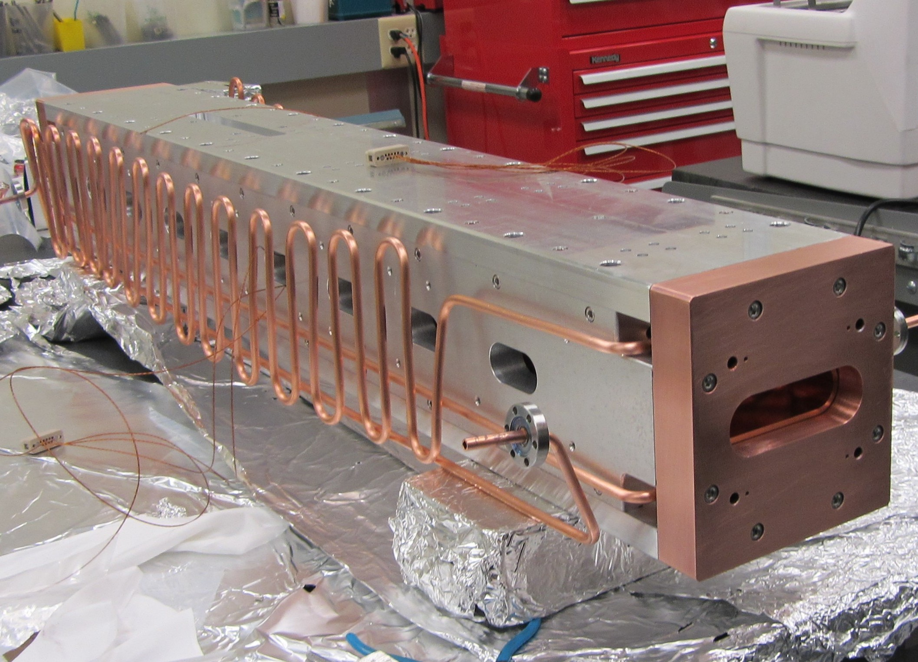
Design and fabrication aspects – Cooling lines
Stationary array and frame cooling line
Movable array cooling line
4

Slide 14
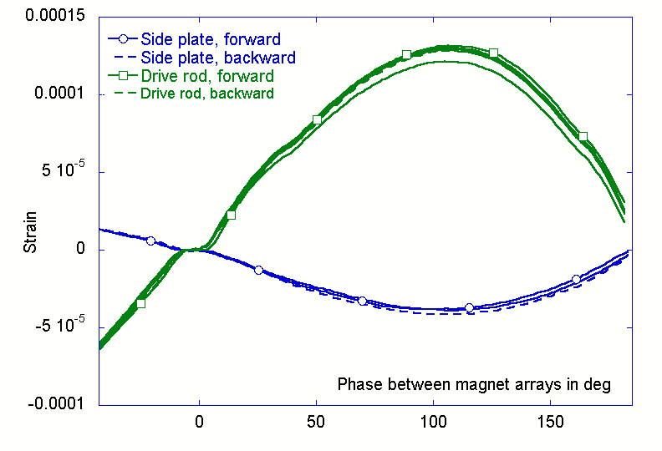
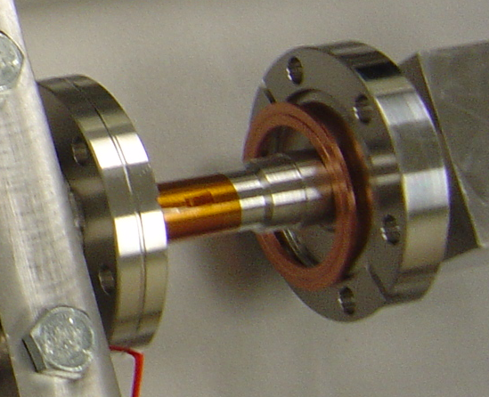
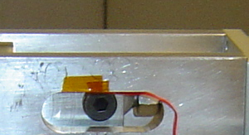
Test result – Mechanics
Two strain gauges attached to drive rod (1) and side plate (2).
Drive rod tension
(1)
Side plate compression
Driver backlash
The drive rod predicted strain for 6.2kN load is 1.4×10-5, measured 12.9×10-5 (-9%)
The side plate predicted strain ~ -4.9×10-5, measured -3.69×10-5.
All strains/stress are well below limits
(2)

Slide 15
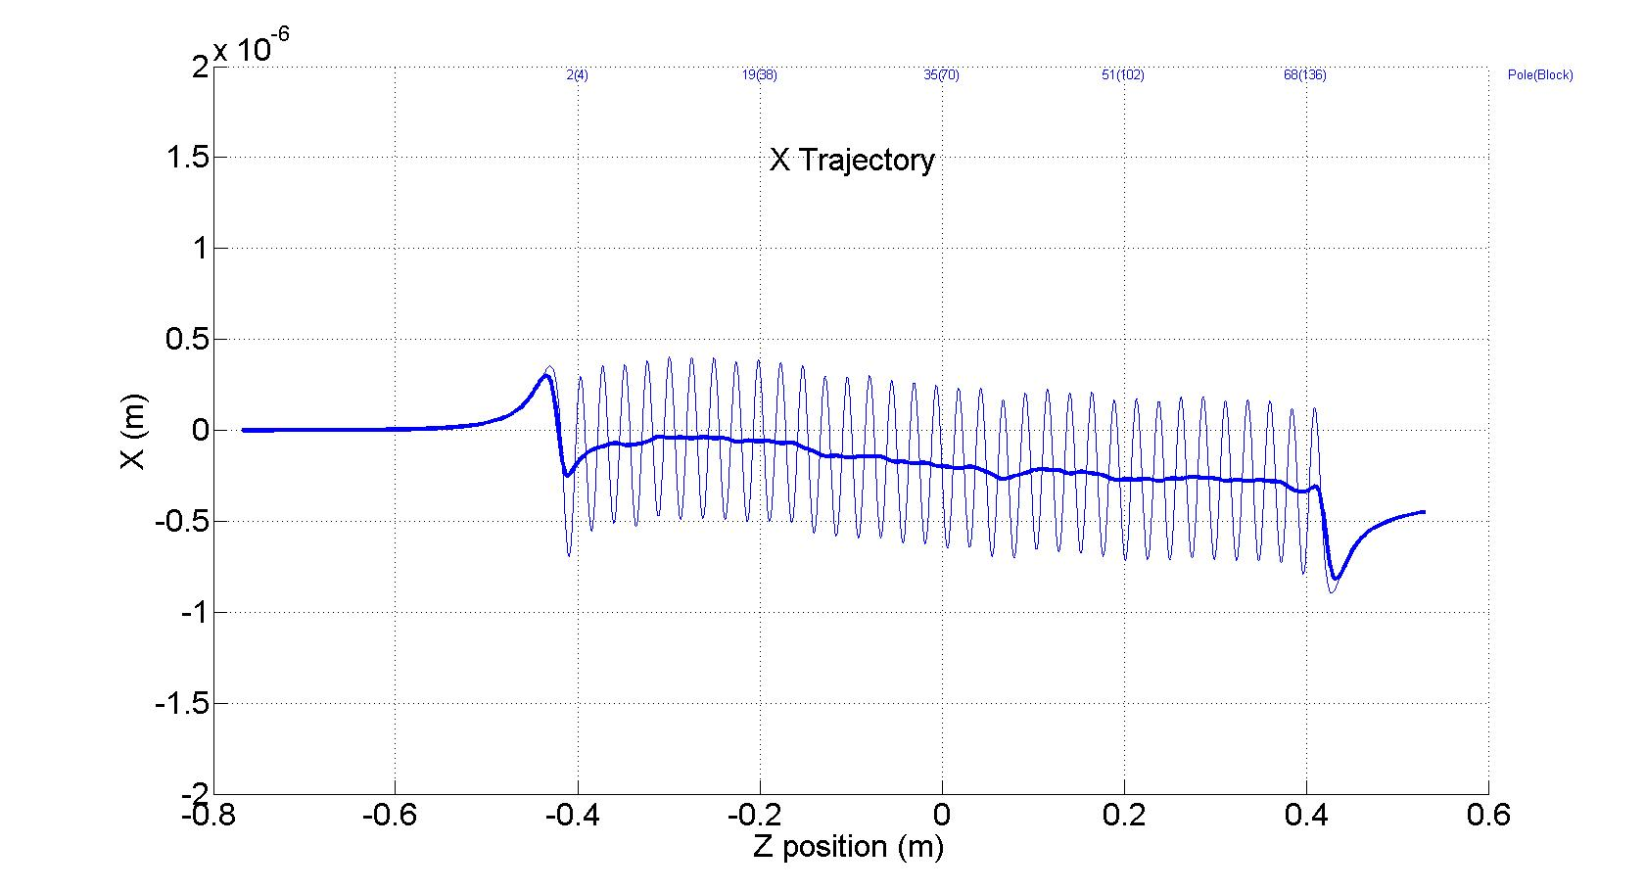
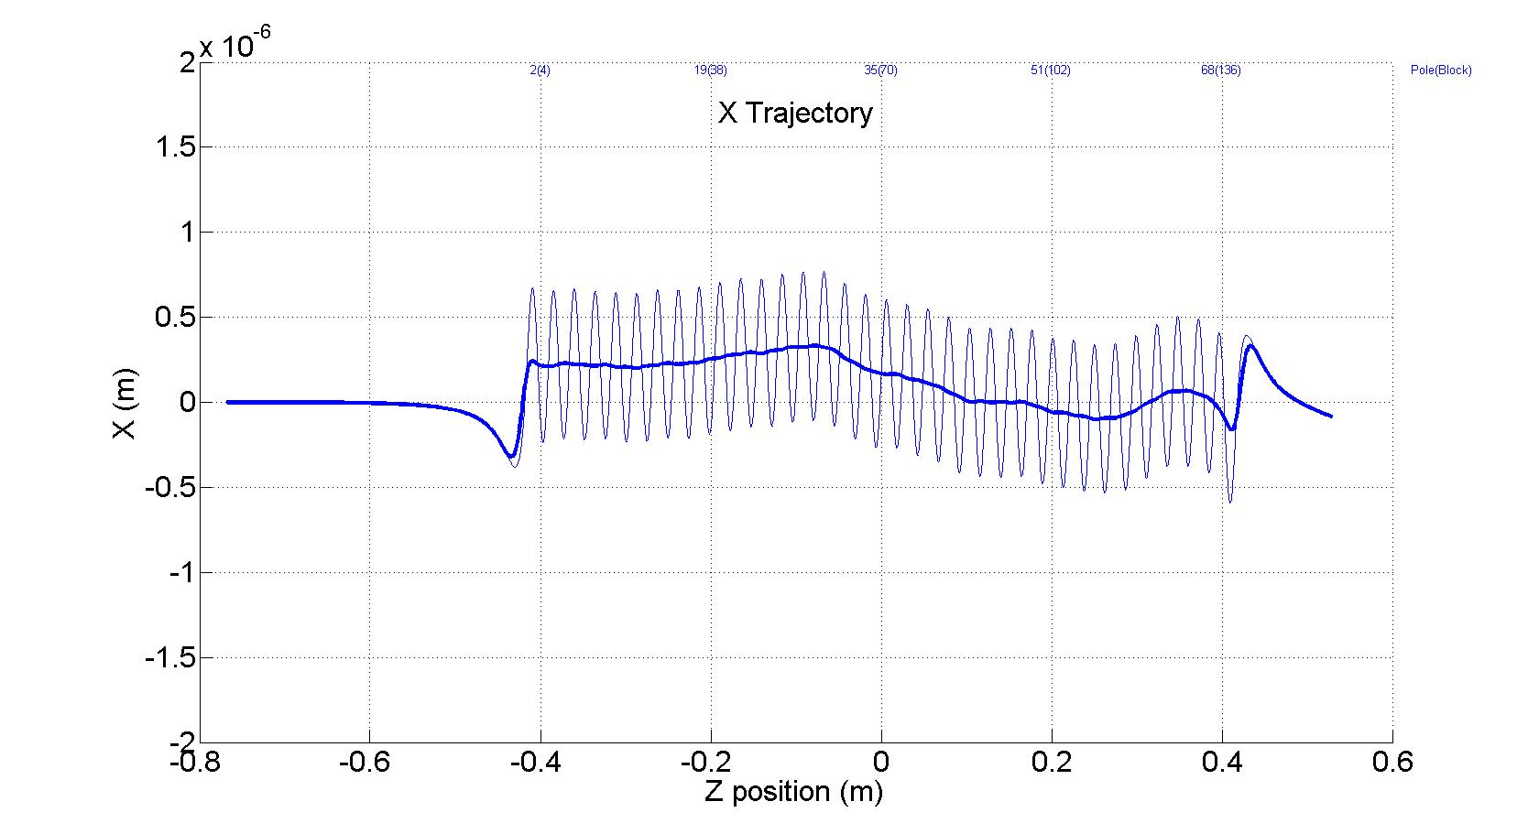
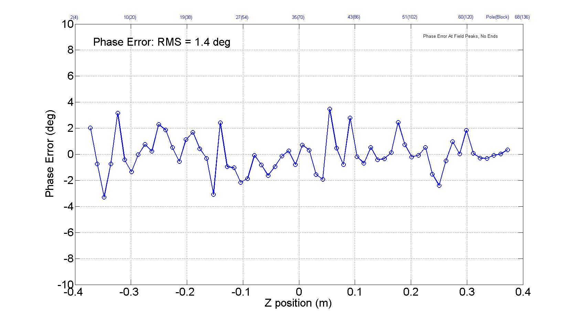
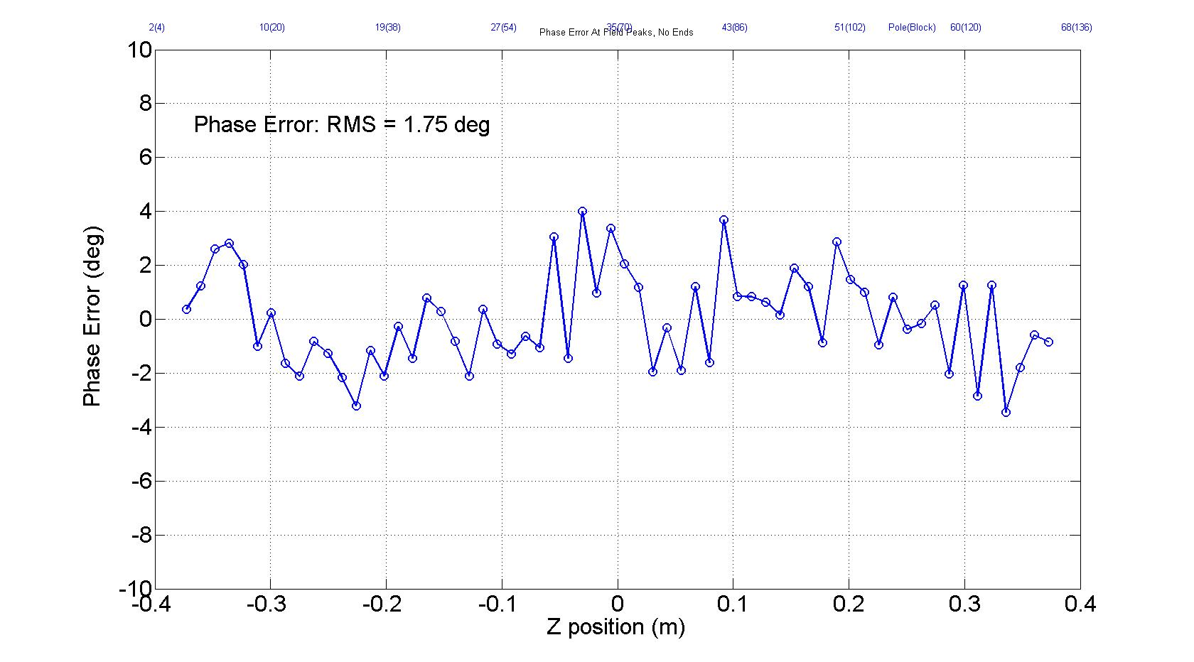
Test result – Magnetic field tuning
Array #1
Array #2

Slide 16
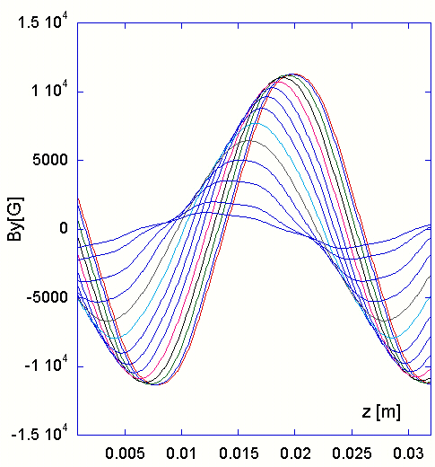
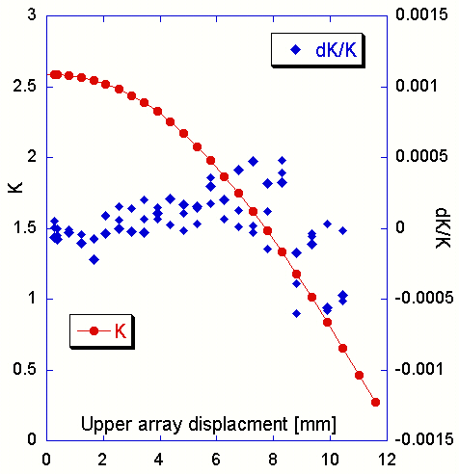
Test result – Magnetic field, “K” repeatability study
Vent slot was used to get access to on axis magnetic field,
Between scans, upper array was moved by 0.5mm
dK/K repeatability ~ 5x10⁻⁴

Slide 17
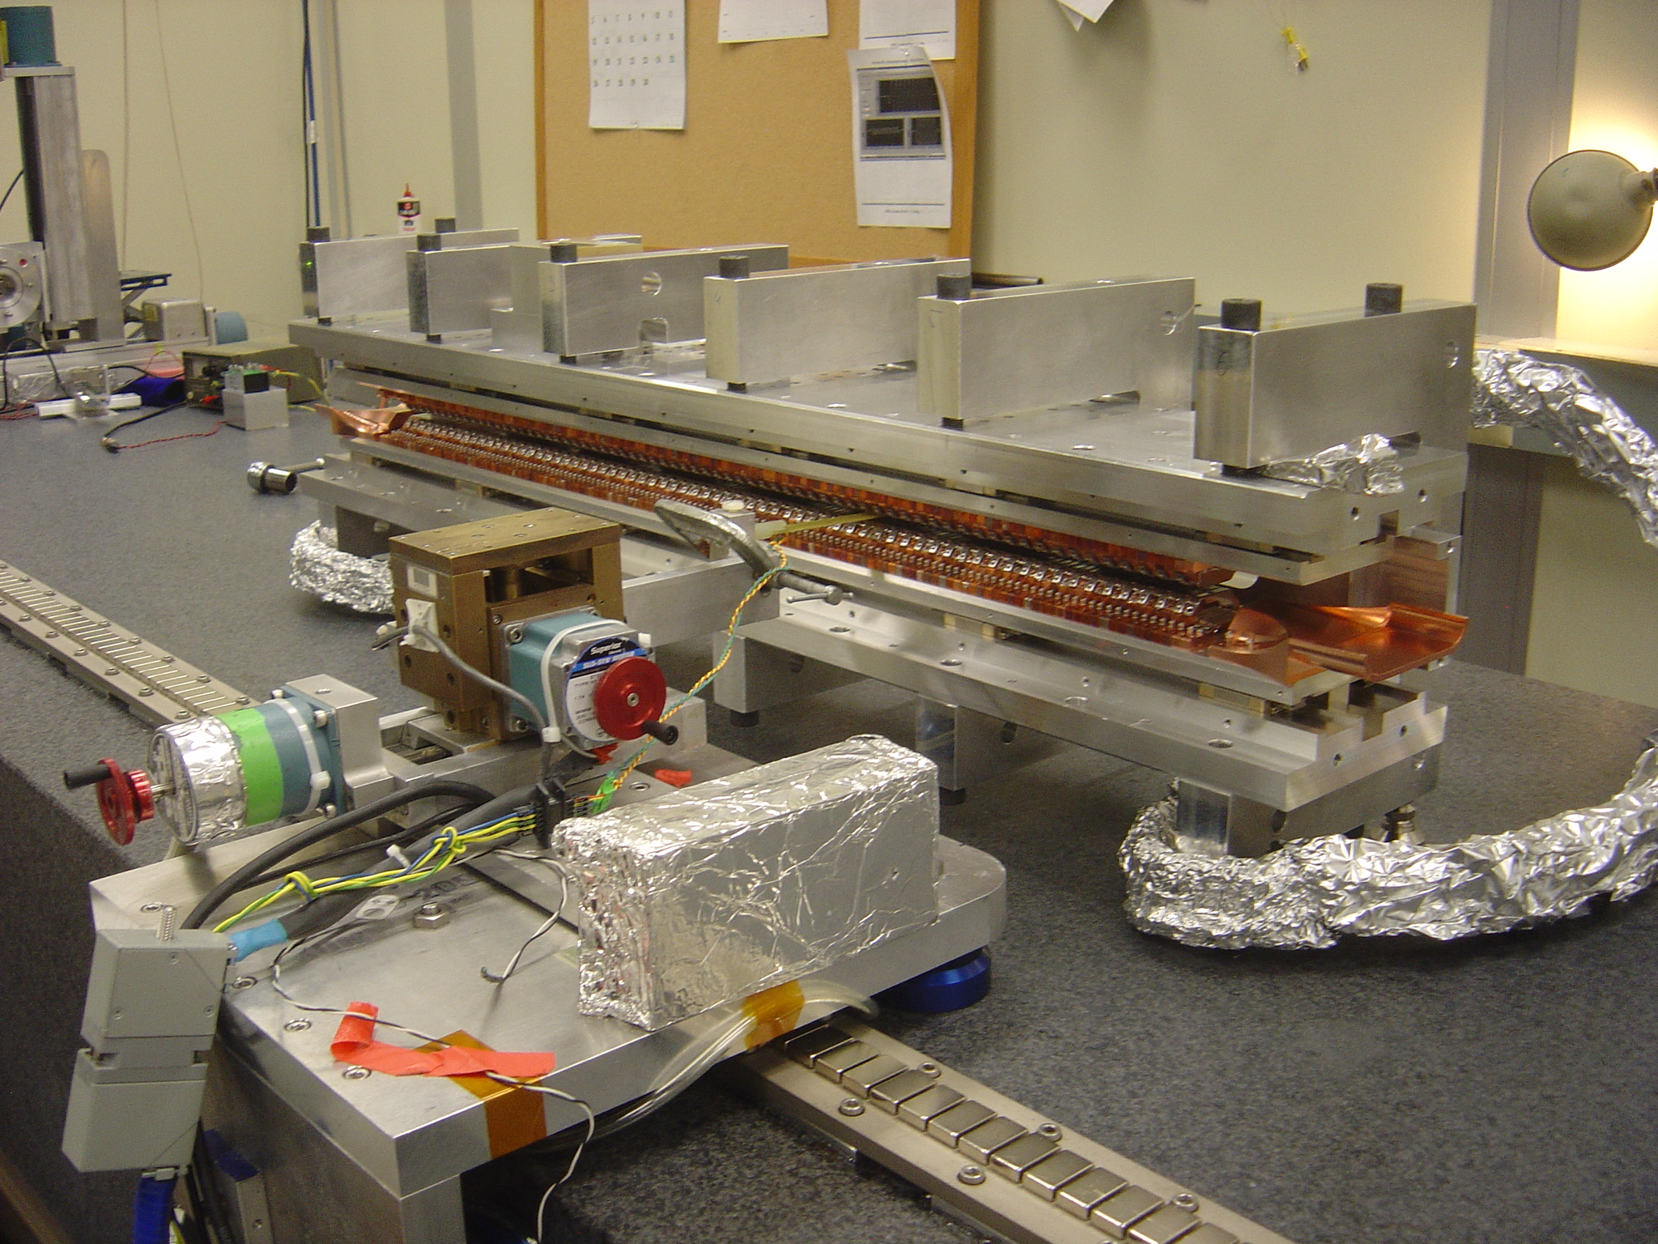
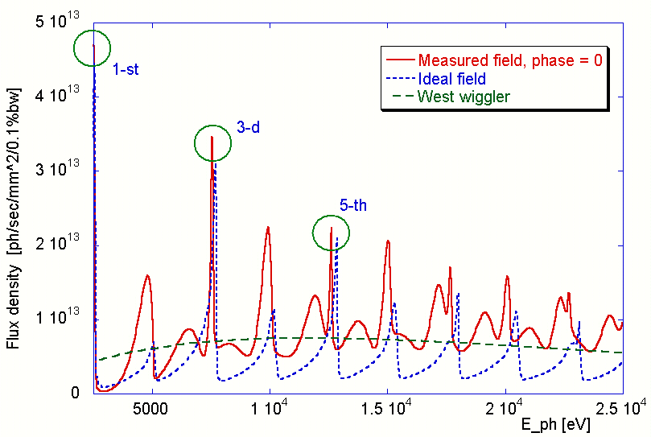
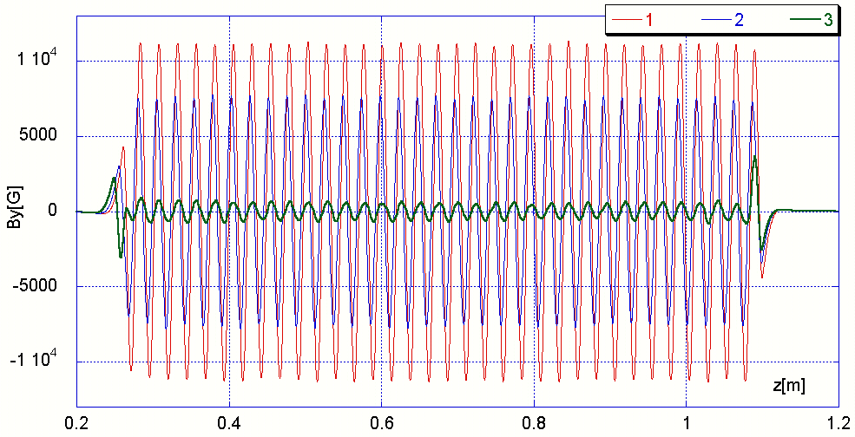
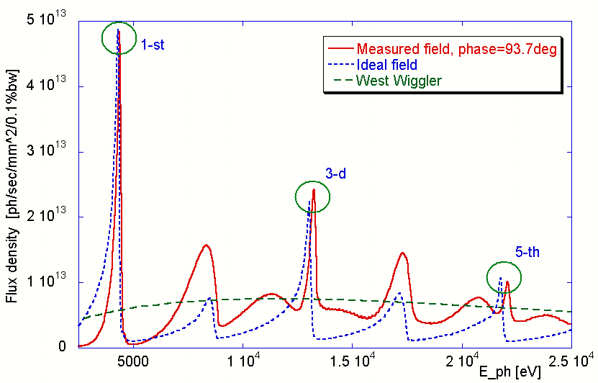
Test result – Magnetic field, full scan

Slide 18
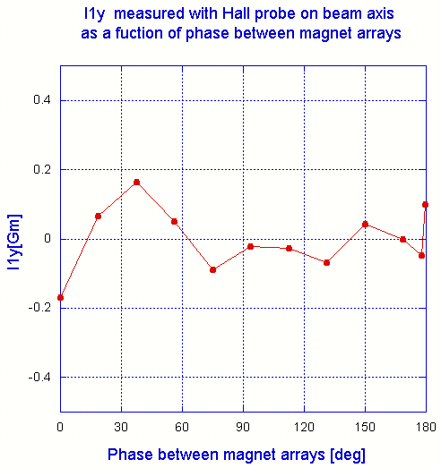
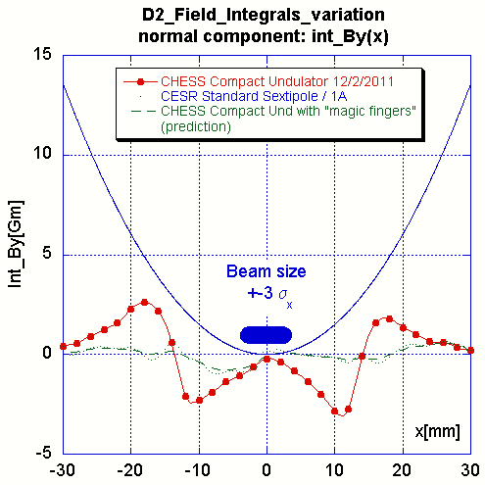
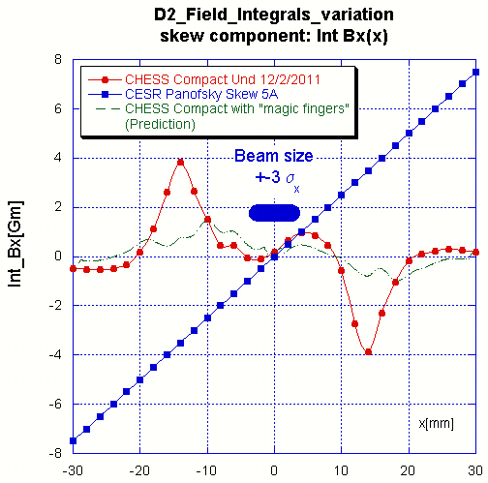
Test result – Field integrals
Vertical field integral measured on beam axis with Hall probe as a function of phase between magnet arrays
Vertical and horizontal field integrals measured with Vibrating Wire as a function of horizontal position, phase between magnet arrays is “zero”
Negligible variation well consisted with observation at SLAC APU test
After beam test will decide if we need “magic fingers”

Slide 19
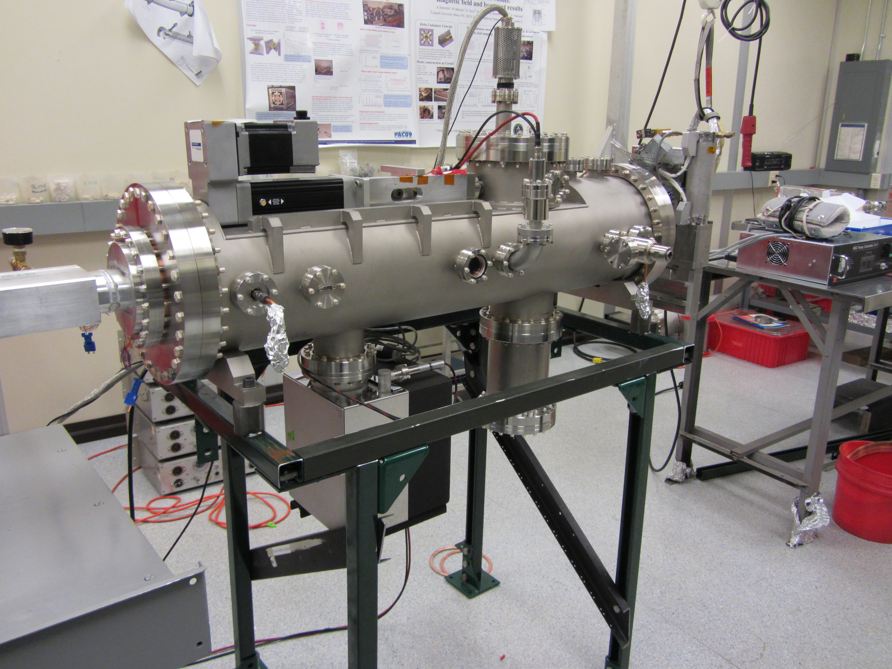
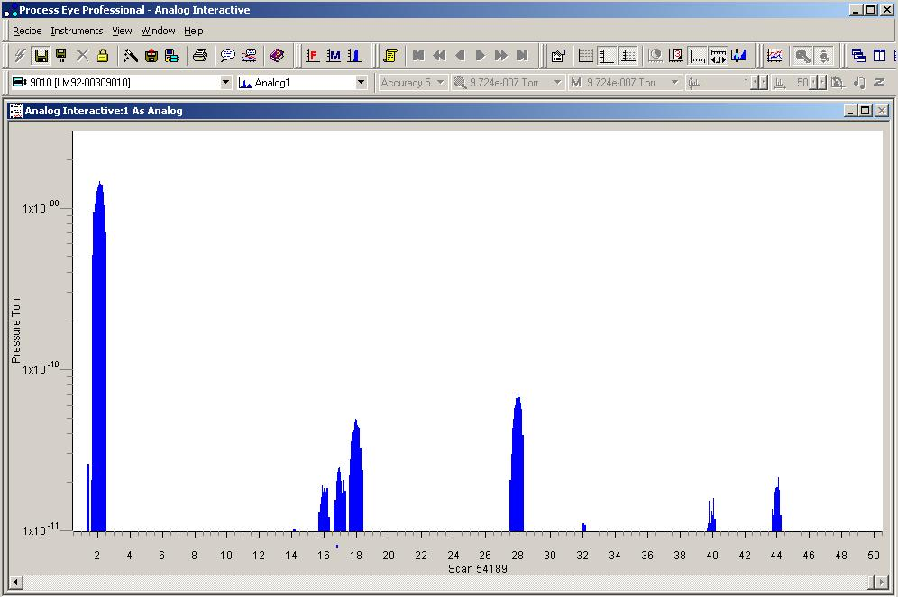
Test result – Vacuum properties
RGA spectra (95% of H2)
1x10-9 Torr
1x10-10 Torr
NEG pump
150 l/sec ion pump
P = 1.9x10⁻⁹ Torr after 100hrs baking at 70degC

Slide 20
Project Status and Plan
Final preparation for installation in the ring is under way. Installation is planned for Apr 15, 2012. Then, we will have a 5 week long test run.
The goal for test run is to evaluate
  Undulator magnetic field properties
    Field integrals variation with phase
    X- ray beam properties and spectrum tuning
  Undulator impedance through it’s effect on multi-bunch electron and beam dynamics.
  Vacuum properties
  Limits for high beam current running
  CHESS “A” and “G” beam lines optics compatibility with undulator radiation.
After 5 week test run, undulator will be removed from the tunnel and depending on test results it will be repaired/modified (or postmortem examined) and prepared for the permanent installation.

Slide 21
Conclusion
We developed and built a compact, inexpensive, in-vacuum undulator magnet and will test it with beam shortly.
Thank you

